Slide 1
Finding the best neighbourhood in Brisbane for families with children
Ramon Rossi
April 9, 2021

Slide 2
Why predict the best neighbourhood in Brisbane?
In today’s globalised world, families with children often need to relocate to another country or city
According to Bader (2019) and Schmidt (2020), important factors when choosing a neighbourhood to live in include:
safety
schools offering excellent education
children-friendly venues such as parks and playgrounds
What if we could take into account all three of these to determine the best neighbourhood to move to?

Slide 3
The Problem
Problem 1: How do you…
gauging the level of crime in a city?
finding out all that city’s venues for each neighbourhood?
gaining the relevant school performance data?
Problem 2: How do you evaluate all the data to arrive at the conclusion of which is the best neighbourhood in Brisbane?

Slide 4
Data acquisition and cleaning
Postcode data
Crime data
School data merged with school performance data
Venue data
Brisbane co-ordinate data

Slide 5
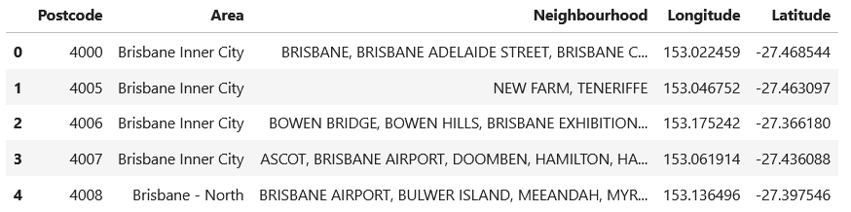
Postcode data (cleaned)
Source: https://www.matthewproctor.com
Brisbane has 74 postcodes

Slide 6
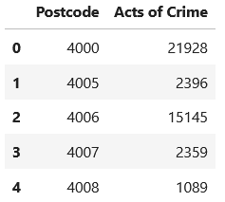
Crime data (cleaned)
Source: Queensland Police Service
Summarises how many acts of crime in each postcode in Brisbane

Slide 7
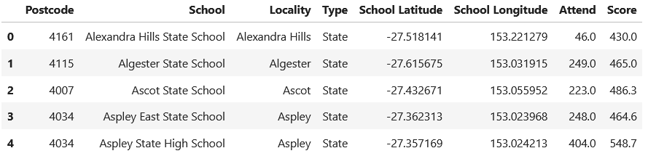
Combined school and school performance data (cleaned)
Sources:
school data: Queensland Government
school performance data: Queensland Curriculum and Assessment Authority
There are 110 Brisbane state schools with performance data
12 schools with no performance data were removed
Another 75 schools were removed for not being state schools

Slide 8
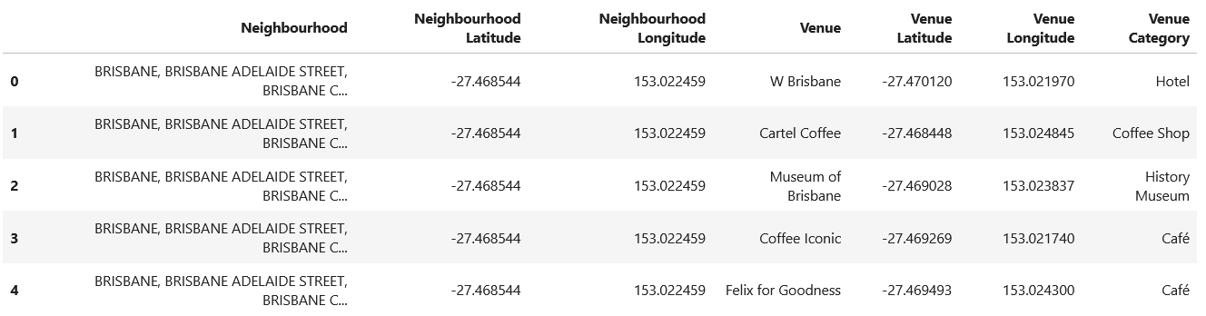
Venue data
Sources: Foursquare API
There is Foursquare data on 450 Brisbane venues

Slide 9
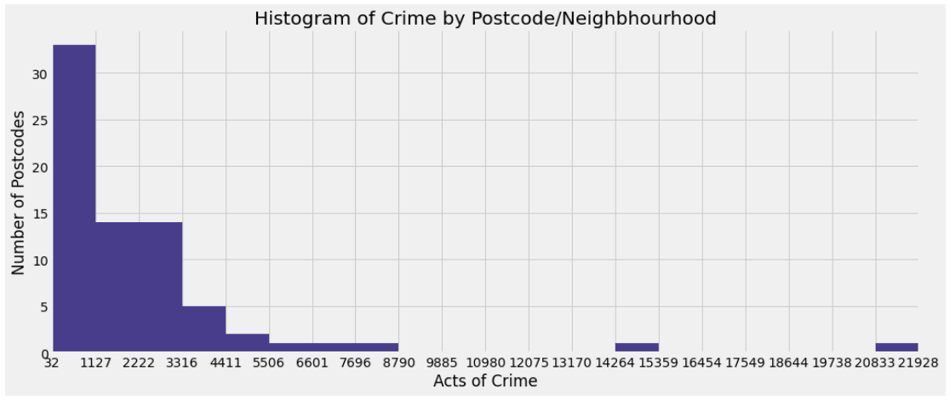
Most postcodes in Brisbane have low crime

Slide 10
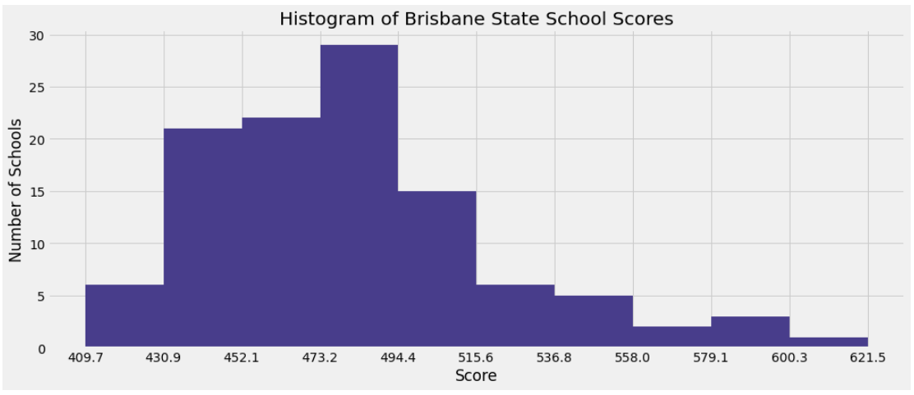
Brisbane school performance is skewed towards the left

Slide 11
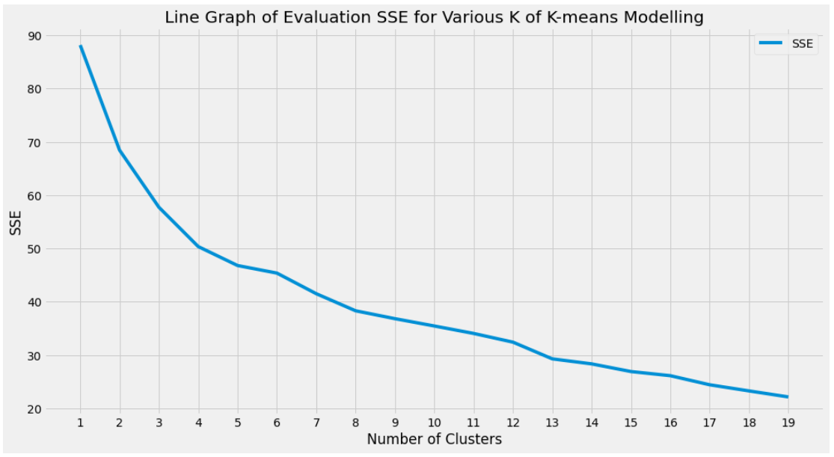
Running k-means algorithm to find the best neighbhourhoods
Different numbers of clusters were tried
‘Eight clusters’ was selected based on:
The elbow-method (when the curve becomes less steep)
Not wanting too many clusters (more clusters requires more analysis time)
slight elbow

Slide 12
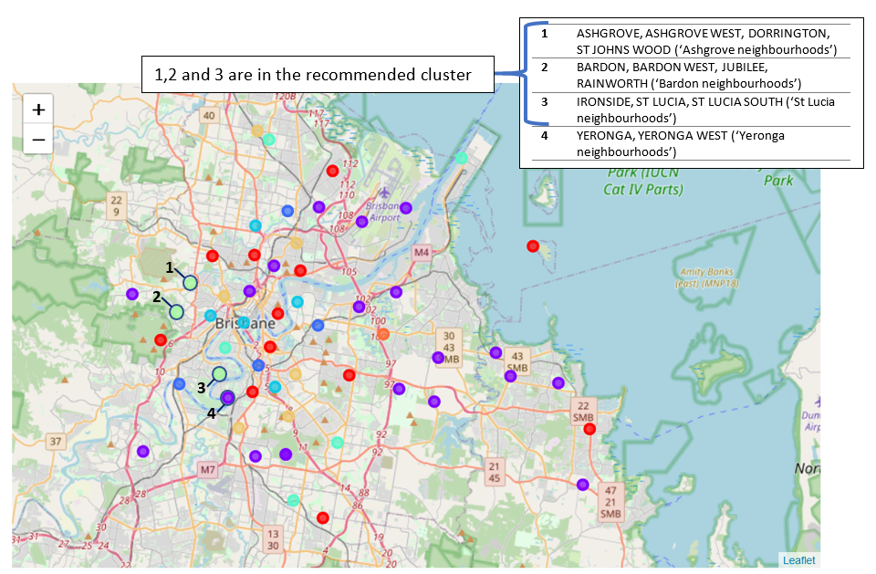
Results: Best Brisbane neighbourhoods found

Slide 13
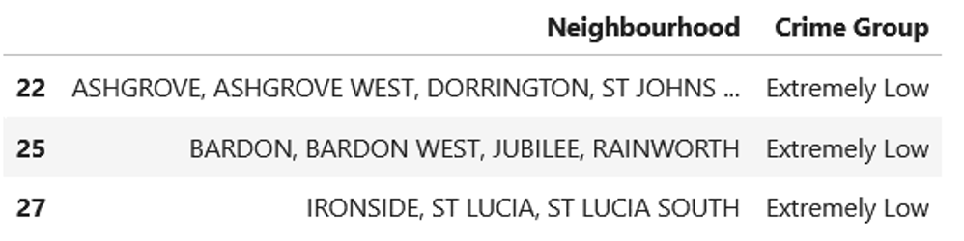
What makes these neighbourhoods the best?
Extremely low crime

Slide 14
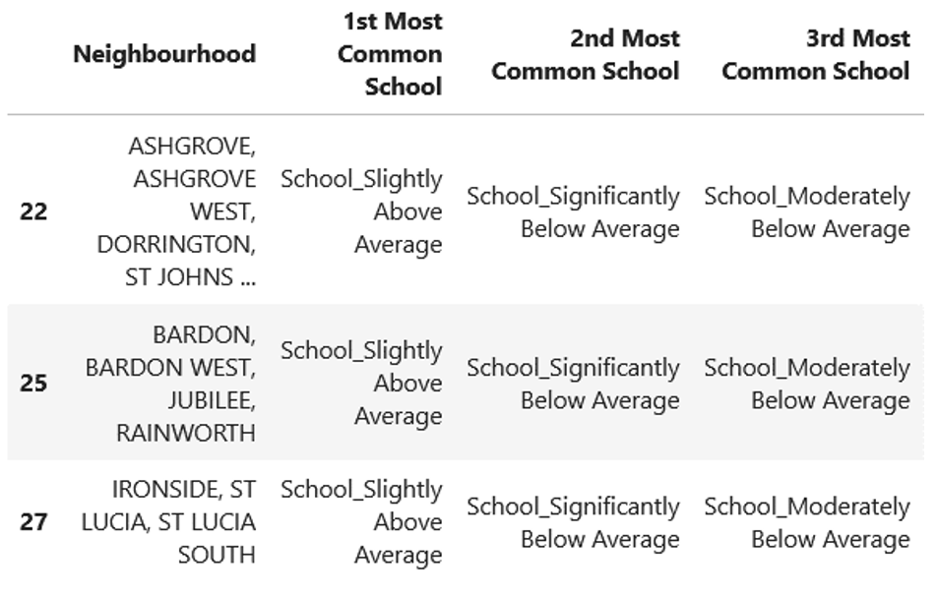
What makes these neighbourhoods the best?
Most common schools are performing above average

Slide 15
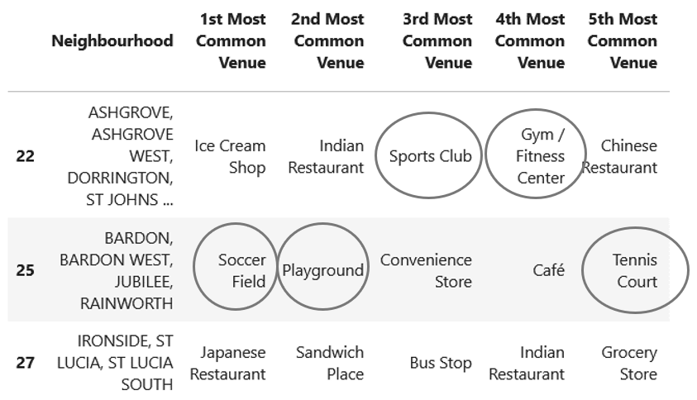
What makes these neighbourhoods the best?
The child-friendly fitness-related venues
What about these venues?

Slide 16
Are St Lucia’s venues the best for families with children?
Reason #1
According to Schmidt (2020), amenities such as ‘grocery stores, convenient stores, cafes, and restaurants’ are also important for families to have close by.
Bader (2019) explains the importance of a grocery convenient store for parents:
As a parent, you want your grocery shopping to be as efficient as possible. If you forget to buy anything, you also would like the store to be close by, to make that extra run quickly, because in the next hour the kids will be back from school and then they have basketball practice.
What about these venues?

Slide 17
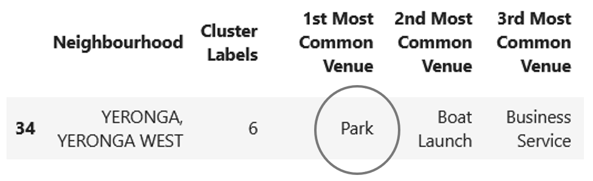
Are St Lucia’s venues the best for families with children?
Reason #2
Families living in St Lucia are very close to the Yeronga neighbourhood so can easily take advantage of the most common venue in the Yeronga neighbourhood: parks.

Slide 18
Conclusion and future directions
A useful model was built to determine the best neighbourhoods in Brisbane for families for children taking into account crime, school performance and venue data
Families with children may want the best neighbourhoods recommended for other cities and countries using similar types of data
Bringing in other factors could be important for families (e.g. cost of living, transportation connections, pollution level). These could also be taken into account for future projects

Slide 19
References
Web Articles
Bader, A. (2019). Best Practices for Choosing a Neighborhood for a Family [web article]. Retrieved from https://www.apartmentlist.com/renter-life/best-practices-for-choosing-a-neighborhood-for-a-family
Schmidt, D. (2020). How to Pick and Move to the Best Neighborhood for You and Your Family [web article]. Retrieved from https://www.thespruce.com/choosing-the-right-neighborhood-2435878
Data Files
QCAA. (2019). NAPLAN 2019 Outcomes – All Queensland Schools. [Data file]. Retrieved from https://www.qcaa.qld.edu.au/downloads/publications/qcaa_stats_naplan_19_outcomes.pdf
Queensland Government. (2020). State and non-state school details. [Data file]. Retrieved from http://opendata.dete.qld.gov.au/state_schools/CentreDetails_May_2020.csv
Queensland Police Service. (2021). Online Crime Map. [Data file]. Retrieved from https://qps-ocm.s3-ap-southeast-2.amazonaws.com/index.html
Proctor, M. (2021). Download Free Database of Australian Postcodes. [Data file]. Retrieved from https://www.matthewproctor.com/Content/postcodes/australian_postcodes.csv

